Slide 1
Booking a musician app
usability study
17.8.2021
Study team for UX
Jaroslava Otmanová

Slide 2
Table of Contents
Section 1 Study Details
Section 2 Themes
Section 3 Insights & Recommendations

Slide 3
Study Details

Slide 4
Project Background
We are creating a booking app to book a musician for a wedding venue. Booking should be clear and fast. Users should have the ability to verify the musician.

Slide 5
Study Details
Research Questions
Participants
Methodology
Do users use the main filter or rather use the search option?
Are there parts of the user flow where users get stuck?
Do users think the app is easy or difficult to use?
5 participants
Two males, two females, aged between 20 and 65
10 of minutes for each user
Czech republic, remote
Unmoderated usability study
Users were asked to do a tasks at a prototype

Slide 6
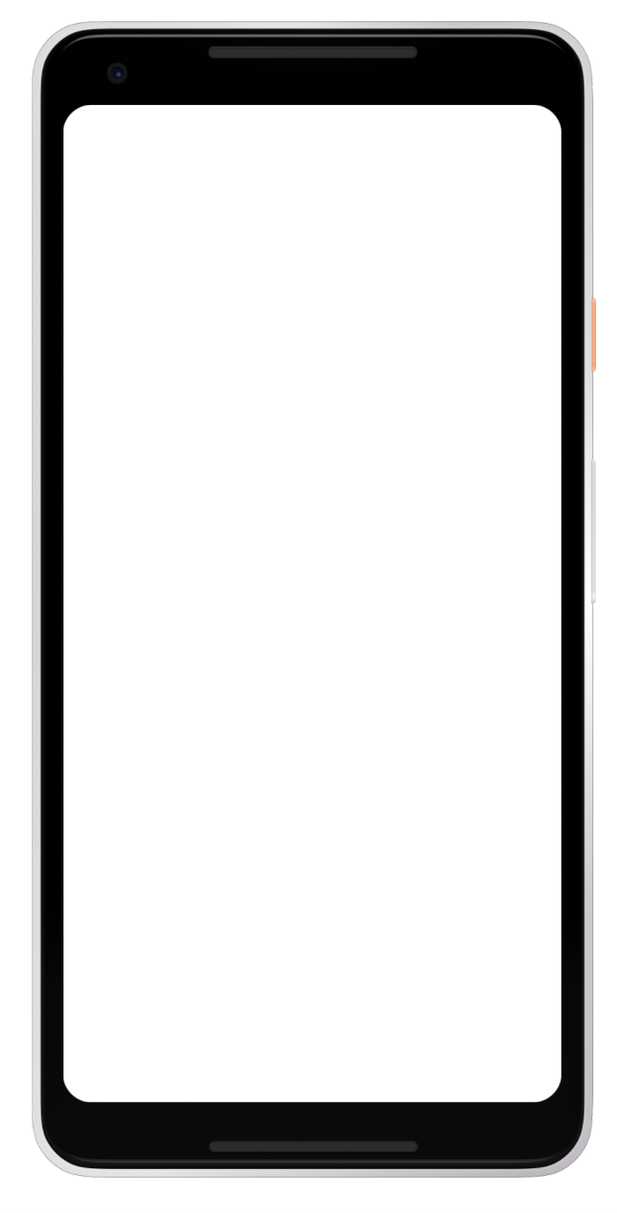
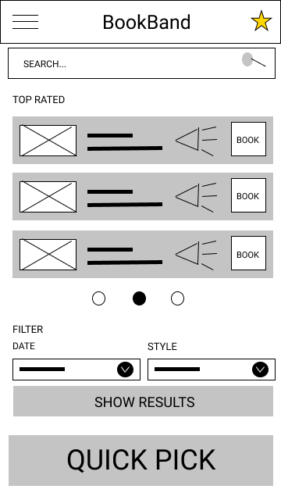

Prototype / Design Tested
Lnk to a prototype: https://www.figma.com/proto/IqNAgGMTvuL9EtIZ4PGIgV/Booking-musician-for-wedding-venue-mobile-app?node-id=1%3A2&scaling=scale-down&page-id=0%3A1&starting-point-node-id=1%3A2

Slide 7
Themes

Slide 8
Most people did not know how or where to find the filter
Supporting evidence from the usability study.
2 out of 5 participants had trouble finding the filter
Two participant were really confused about the filter.
“What should I select? Should I filter from those top rated?”
a

Slide 9
Insights & Recommendations

Slide 10
Research insights
Selecting a musician is unclear
Favorite star is not clear for everyone
Getting to musician detail is unclear
Finding filter is difficult
Filter should be placed on top of the page so it is easy to find.
Users wants to know on the first view that they need to tap the row.
The star is a common feature as a favorite shortcut but not everyone knows that.
Users need more highlight to be sure they need to tap the row.

Slide 11
Recommendations
Rearrange the home screen of the app so the user can find the filter on the first view
Highlight in better way the musician detail row in filtered results so the user knows he need to click it to get to the detail
Think about the design of the favorite star feature

Slide 12
Thank you!

